Slide 1
Are our smart devices really that smart ?
Security in the Internet of Things (IoT)
Christopher McDermott
c.d.mcdermott@rgu.ac.uk

Slide 2
Cyber Security
Cyber Security Trends
UK migration to IPv6
IoT Security vulnerabilities
Final thoughts and role of BCS

Slide 3
Cyber Security Trends
In Q2 2016 DDoS attacks continue to become more
frequent, persistent and complex
75%
Increase in
DDoS
Year on year
256 Gpbs
Peak attack size and
64 Mpps
64% of
attacks employed
multiple
attack types
56%
of DDoS attacks are
UDP based
Source: Verisign DDoS Trends Report Q2 2016
Notes:
Imperva's annual "DDoS Threat Landscape Report", DDoS attacks rose by 221% between April 2015 and March 2016
Gbps – Giga (billion) bit per second (how many bits can be processed by the device)
Mpps - Mega (million) packets per second (how many packets can be processed by the device)

Slide 4
Cyber Security Trends
64% of
attacks employed
multiple
attack types
Common (OSI Layer 3&4) Attack Types
DNS Reflection (Amplification)
NTP Reflection
SYN Flood
GRE Flood
Http (layer 7) GET/POST attacks are increasingly being used and are difficult to detect
Source: Verisign DDoS Trends Report Q2 2016
Notes:
Imperva's annual "DDoS Threat Landscape Report", DDoS attacks rose by 221% between April 2015 and March 2016

Slide 5
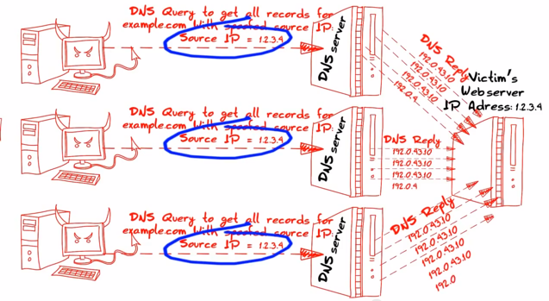
DNS Amplification Attack
56%
of DDoS attacks are
UDP based
DNS reflection
The most common
UDP attack
[1]

Slide 6
Emerging Cyber Security Trends
Attacks from mobile devices are increasing
Distributed Denial of Service as a Service (DDaaS)
Ransomware as a Service (RaaS)
DDoS for Bitcoin (DD4BC)

Slide 7
Ransomware Attack
Victim’s computer is infected
Ransomware contacts the command and control server
Ransomware generates unique keys and encrypts victim files
Message sent to victim demanding payment to regain access to encrypted files
Examples: Cryptolocker, Toxicola, Encryptor RaaS
Source: Verisign 2016 Cyber Threats and Trends Report
[2]

Slide 8
DDoS for Bitcoin Attack
DD4BC sends extortion
e-mail
DD4BC initiates small DDoS attack
Victim has 24 to 48 hours to pay ransom
Victim pays ransom (likely) or ensures mitigation is in place
Future: DDoS-for-hire
Source: Verisign 2016 Cyber Threats and Trends Report
[3]

Slide 9
June 6th 2012

Slide 10
IPv6 Migration
Darker green =
greater the deployment
World IPv6 adoption 14.81%
UK IPv6 adoption 15.9%
[4]

Slide 11
IPv6 Migration
UK IPv6 adoption 15.9%
Sky (80% ready)
BT (early 2017)
Virgin Media (mid 2017)
2^32 = 4,294,967,296
2^128 = 340,282,366,920,938,463,463,374,607,431,768,211,456
Every device can now be allocated a public IPv6 address and be accessible from anywhere

Slide 12
IoT Security
Education / Legislation
Standardised firmware/software
Standardised network and wireless protocols
Cryptography
Backdoor credentials

Slide 13
IoT Security
Education / Legislation
► Cheap IoT devices with poor security allowed to enter the market
► IoT devices manufactured to be user friendly (Plug and Play)
► Universal Plug and Play (UPnP) enabled routers
► Weak or default passwords

Slide 14
IoT Security
Education / Legislation
Standardised firmware/software
► APIs lack standardisation
► APIs often do not include local authentication

Slide 15
IoT Security
Education / Legislation
Standardised firmware/software
Standardised network and wireless protocols
► Bluetooth Low Power, Zigbee, Z-wave, 6LoWPAN
► Unauthenticated communications

Slide 16
IoT Security
Education / Legislation
Standardised firmware/software
Standardised network and wireless protocols
Cryptography
► Cryptography not available due to low computational power
► Cryptography not included to keep manufacturing costs low
► Cryptography not included to maintain plug and play ethos
► Cryptography included but same key used on every device

Slide 17
IoT Security
Education / Legislation
Standardised firmware/software
Standardised network and wireless protocols
Cryptography
Backdoor credentials
► Hard coded credentials
► Weak or default user credentials used

Slide 18
IoT Security
How long to infect an IoT security camera when connected to the Internet ?
98 seconds

Slide 19
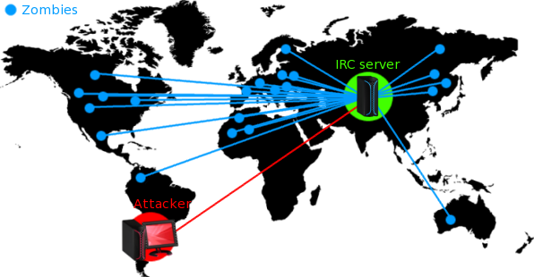
New playground for Botnets ?
Verisign DDoS Trends Report Q2 2016
256 Gpbs
Peak attack size
IoT Botnet Activity Q3&4 2016
1200 Gpbs
Peak attack size
[5]

Slide 20
Mirai IoT Botnet
September 20th 2016:
Mirai used to attack website of Security journalist Brian Krebs with 620Gbps DDoS attack
September 23rd 2016:
Mirai botnet used to attack OVH web hosting company with 1Tbps DDoS attack
October 21st 2016:
Mirai botnet used to attack DYN DNS provider with 1.2 Tbps attack
Impacted sites include but are not limited to:
PayPal, Twitter, Reddit, GitHub, Amazon, Netflix, Spotify

Slide 21
Mirai IoT Botnet
[6]

Slide 22
Mirai botnet dictionary list
Mirai botnet used a multi vector attack model: DNS, UDP GRE, SYN, ACK flood attacks
Dictionary list of 60 default credentials
Telnet used to spread the virus
Targeted IP security cameras, DVRs, Routers

Slide 23
Targeted Credentials

Slide 24
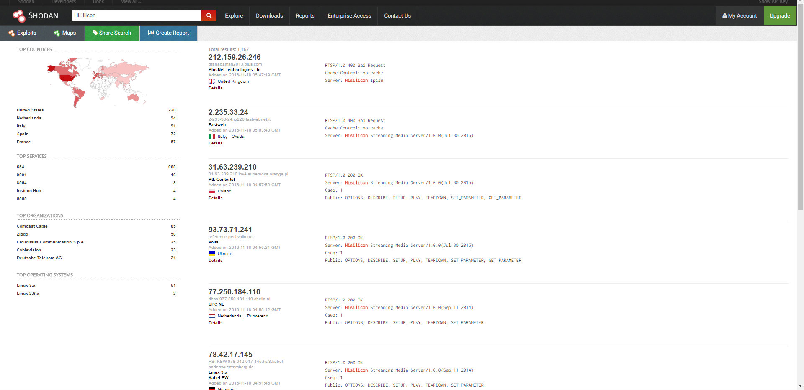
Shodan.io

Slide 25
Mirai Botnet Analysis
The Million $ Question ?
[7]

Slide 26
Mirai Botnet Analysis
я люблю куриные наггетсы
I love Chicken Nuggets
[7]

Slide 27
What can BCS do ?
Education / Legislation
Standardised firmware/software
Standardised network and wireless protocols
Cryptography
Backdoor credentials

Slide 28
Quick tips
Educate people not to use default/generic passwords
Create strong passwords http://passwordsgenerator.net/
Disable all remote (WAN) access to your devices. Test open ports: http://www.yougetsignal.com/tools/open-ports/
Check for Mirai malware. Using botnet scanner: https://www.incapsula.com/mirai-scanner/

Slide 29
Secure Password Strategy
Have two (possibly three) levels of password security
Level 1 reusable password for sites that hold no personal data
Level 2 unique passwords for sites holding financial or critical personal data
(Bruce Schneier) method of remembering a phrase not a password and use it to generate a password:
“The first house I ever lived in was 613 Fake Street. Rent was £400 per month.
TfhIeliw613FS.Rw£4pm.

Slide 30
References
2016. Download DDoS Report On DDoS Attack Trends And Insights - Verisign. [ONLINE] Available at: https://www.verisign.com/en_GB/security-services/ddos-protection/ddos-report/index.xhtml. [Accessed 18 November 2016].
2016. 2016 Cyberthreats and Trends Report. [ONLINE] Available at: https://www.verisign.com/en_GB/forms/reportcyberthreatstrends.xhtml. [Accessed 18 November 2016].
Image Sources:
[1] https://i.imgur.com/zJuux3C.png
[2] https://www.verisign.com/en_GB/forms/reportcyberthreatstrends.xhtml
[3] https://www.verisign.com/en_GB/forms/reportcyberthreatstrends.xhtml
[4] https://www.google.com/intl/en/ipv6/statistics.html
[5] https://blog.appriver.com/wp-content/uploads/2009/09/botnetmap1.png
[6] https://www.incapsula.com/blog/malware-analysis-mirai-ddos-botnet.html
[7] https://www.incapsula.com/blog/malware-analysis-mirai-ddos-botnet.html
[8] https://www.incapsula.com/blog/malware-analysis-mirai-ddos-botnet.html

